Slide 1
Weather Way Farers
A Website of innovation on climate changes

Slide 2
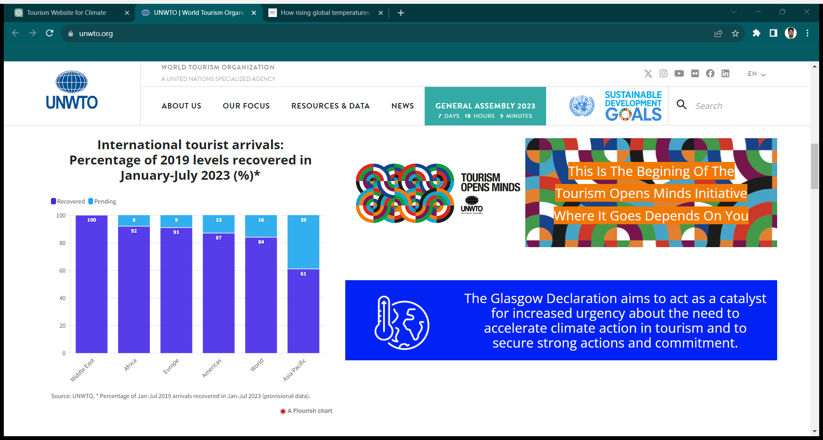
Global impact on tourism due to climate changes
The above commitment was undertaken by UNWTO (United Nation World Tour Organization)

Slide 3
IDEA OVERVIEW
Homepage:
Provide an attractive and intuitive interface to welcome visitors.
Briefly introduce the purpose of the website: promoting responsible tourism, raising climate change awareness, and facilitating access to essential services.
Tourism Places:
Create a section dedicated to showcasing various tourism destinations, highlighting their unique features, cultural significance, and environmental sustainability efforts.
Include images, descriptions, activities, and any eco-friendly initiatives associated with each place.
Climate Change Awareness:
Create a dedicated section or blog to educate visitors about climate change, its impacts on the local region, and global efforts to combat it
Interactive Features:
Implement interactive elements such as quizzes, surveys, or interactive maps to engage visitors and assess their knowledge about climate change and sustainable tourism.
Contact and Support:
Offer a clear and accessible contact form or information for users to reach out for inquiries, assistance, or reporting any issues related to the website or the featured destinations.

Slide 4
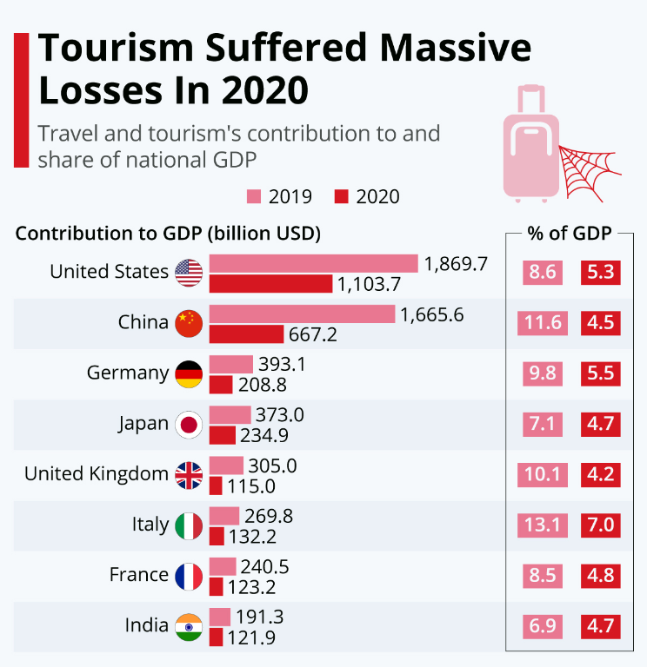
Market Prospects
To Overcome This Issue
The market prospects for a website focusing on tourism places, weather information, essential services, and climate change awareness are promising, given the growing interest in sustainable and responsible tourism.
Online Travel Planning Trends:
With the increasing reliance on the internet for travel planning, tourists often conduct thorough research online before making travel decisions. Your website can serve as a go-to platform for travelers looking for comprehensive information and guidance for their trips
Potential for Partnerships and Advertising Revenue:
Collaborations with eco-friendly hotels, travel agencies, and sustainable tour operators can create revenue streams through partnerships and advertising. Promoting responsible tourism providers can benefit both your website and the businesses involved.
Global Tourism Growth:
The tourism industry continues to grow, and various regions around the world are promoting tourism to boost their economies. Providing information about diverse destinations taps into this global growth trend.
To maximize market prospects, consider staying updated with the latest trends, continuously improving user experience, optimizing for mobile devices
You can see the graph which shows the losses for the all over world cause of cancelling tour’s by climate changes like earth quake ,flood etc..,

Slide 5
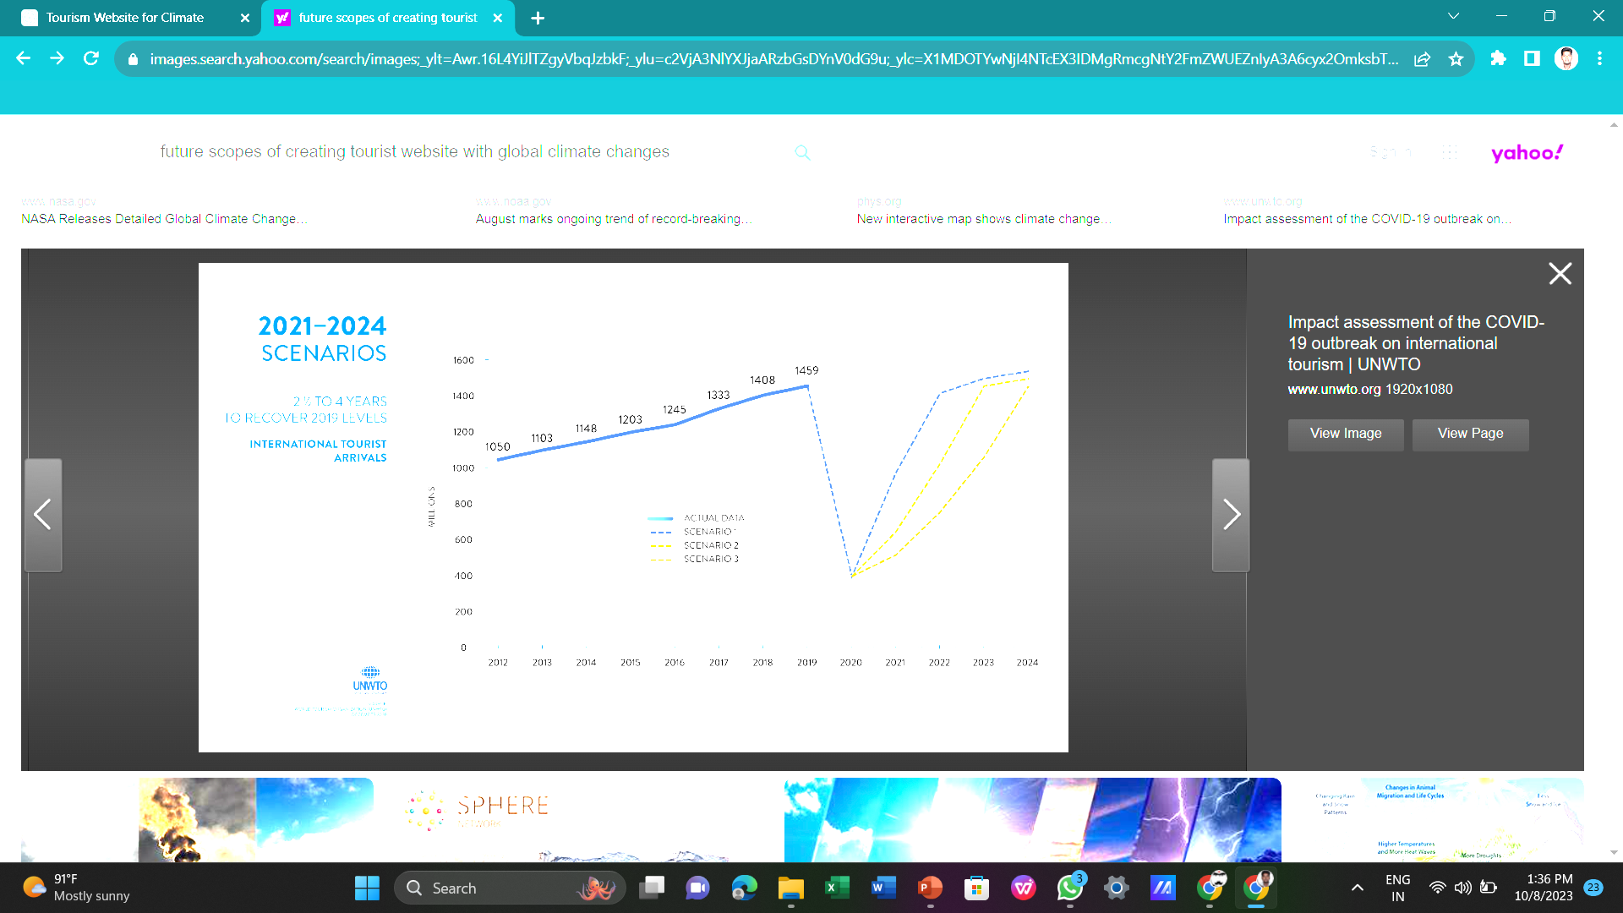
Future Scope
This graph shows our future plan
By introducing multi language support across all over the world
And plan to introduce voice assistants to enhance user engagement and accessibility
Develop a mobile app version of the website to provide on-the-go access to weather updates, local services, and sustainable travel tips.
. Offer real-time data on the environmental and climate challenges specific to each location, helping travelers make informed choices.

Slide 6
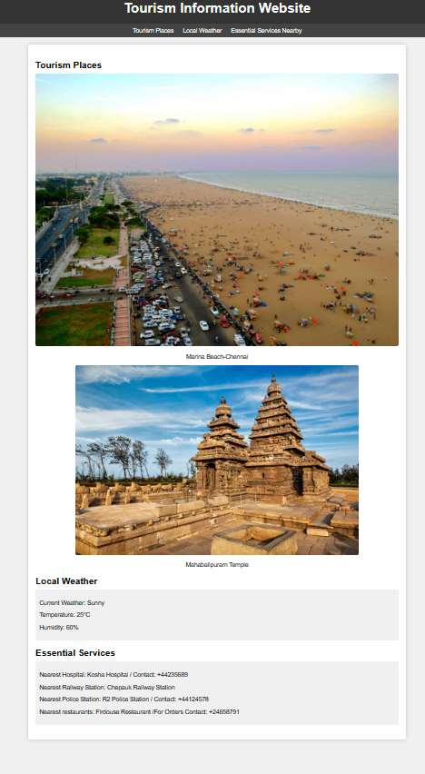
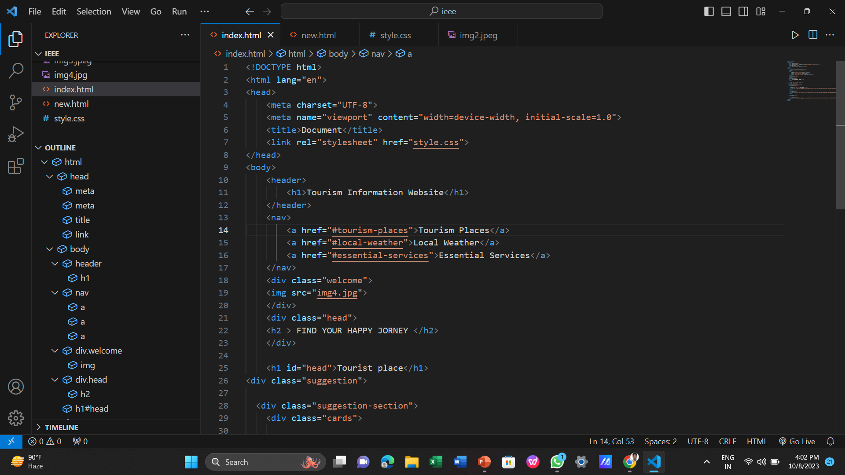
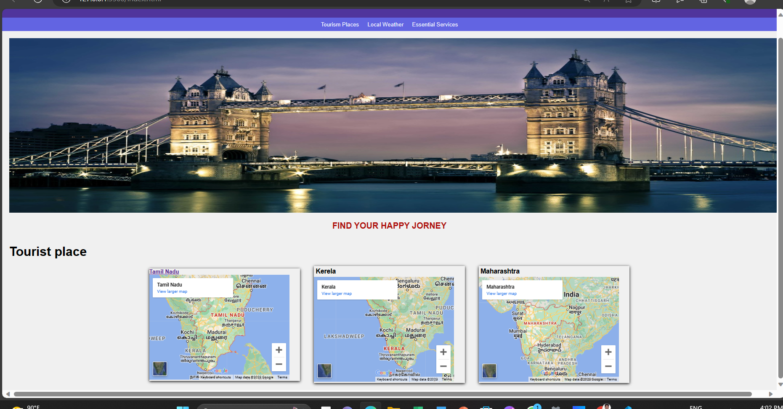
Sample website we created

Slide 7
Thank you

